Slide 1
MODULE 7 :
Miscellaneous

Slide 2
Environment Variables - Basics
Environment Variables are variables that store information about the system
They can be used to store data, set configuration options and customize the shell environment under Linux
Can be divided into two types:
System Environment Variables
Local variables

Slide 3
Environment Variables - Basics
System Variables:
Standard Names
Used by the Shell
Normally they are All Caps
More can be added by the users for their usage
Local Variables
User selected names
Local to a shell (not passed to children shells or programs)
Convention is to avoid all caps to differentiate them

Slide 4
Environment Variables - Usage
Examples of use of Environment Variables (not a full list) :
Configure look and feel of shell such as colors and bash prompt
Time zone, host name,…
Search path for executables, or any types of files
Default values for some system configurations
Some configuration options for specific programs

Slide 5
Process Environment
Linux does not maintain or store a global set of environment variable for the system
Each running program (process) will have its own environment settings
This means different processes may have different environment settings
The environment settings for each running process in the system can be listed by viewing the file /proc//environ
Where pid is the Process ID

Slide 6
Process Environment
Process receive their environments settings by:
By inheritance
Each process will have a parent process that started it
The child process inherits the environment settings of its parent process
that each program (process) that is started inside the shell, is a child of that shell, hence processes started from the shell, inherit the shell environment settings
a non-login shell is a child of a login shell, hence it inherits its environment settings at startup
local variables are not inherited to child shells or processes

Slide 7
Process Environment
Process receive their environments settings by:
By Startup Scripts
Some programs source some scripts at startup
These scripts may include some environment settings that is added to the process settings inherited from its parent
We have already discussed this for login/non-login shell startup
Login Shells /etc/profile ~/.bash-profile or ~/.bash-login or ~/.profile
Non-Login Shells /etc/.bashrc or /etc/bash.bashrc ~/.bashrc
GUI Applications (applications started from the GUI) ~/.xinitrc

Slide 8
/etc/profile
To add settings that will apply to all shells, and all users… we need to put it in /etc/profile
In most distributions, it is preferred not to edit /etc/profile directly
To enable that, /etc/profile has a loop that sources all scripts with extentions *.sh in the folder /etc/profile.d
Accordingly, all we need to do is to put our settings in a new script file inside this folder and call it something.sh then make it executable
Our script will be called from /etc/profile and hence our settings will be read by login shells, and inherited by non-login shells

Slide 9
export
To Set a local variable in the shell $ My_Var=5 This way My_Var will not be inherited to any child or process of the current shell
To Convert it into an Environment Variable $ export My_Var This way My_Var will be inherited to any child shell or process of current shell
To bring it back to be just a local variable $ export -n My_Var
To reset an Environment variable $ export My_Var=
To Completely remove the variable $ unset My_Var

Slide 10
List Environment variables
set
Printenv
env

Slide 11
Common Environment variables:
PATH
It is a list of directories separated by a colon “:” /home/tom/bin:/usr/local/sbin:/usr/local/bin:/usr/sbin:/usr/bin:/sbin:/bin:/usr/games
This list represents the search path for commands and binaries, when you issue a command
To show the current search path $ echo $PATH
To add a folder to the end of the path $ export PATH=$PATH:/usr/bin
To add a folder to the beginning of the path $ export PATH=/bin:${PATH}

Slide 12
Common Environment variables:
PS1
Responsible for setting the shell prompt
\u →username
\h →hostname
\W →current working directory
Example $ export PS1=[\u@\h \W]\$

Slide 13
Common Environment variables:
SHELL
Contains the path to the login shell
Example:
$ echo $SHELL /bin/bash

Slide 14
Common Environment Variables:
EDITOR
TERM
HOME
HOSTNAME

Slide 15

Links in Unix
On the UNIX command line, the tool ln abbreviates the term link.
It allows you to create an additional reference to a file, or directory.
It does that by adding an additional name of an entry in the file allocation table of the file system.
It is an essential tool in unix and it is part of the package coreutils.

Slide 16
Links in Unix(contd.)
Links on unix file system are of two types:
Hardlink
Linking files by reference
System maintains a count of the number of links
Does not work across file system
Softlink or Symbolic link
Linking files by name
No counter is maintained
Work across file system

Slide 17
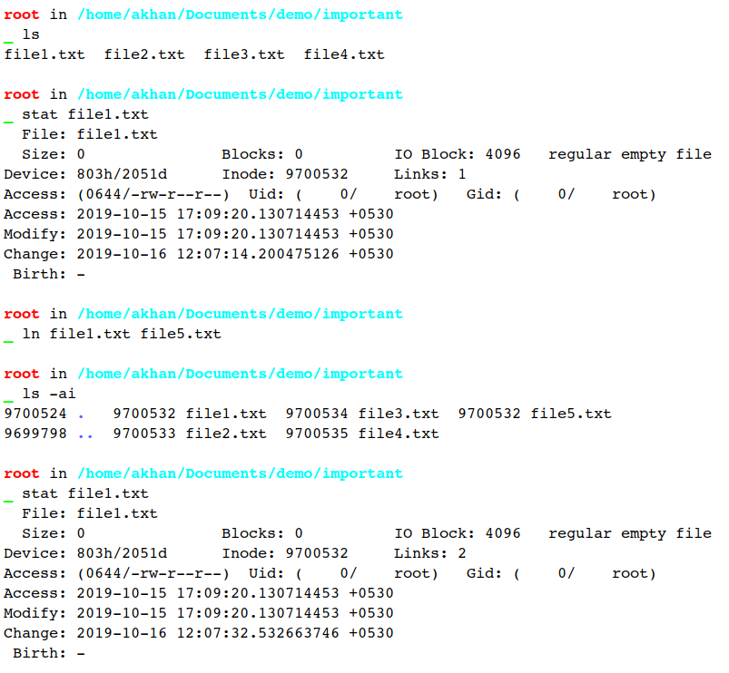
A hard link is a UNIX path name for a file.
It is created with ln command.

Slide 18
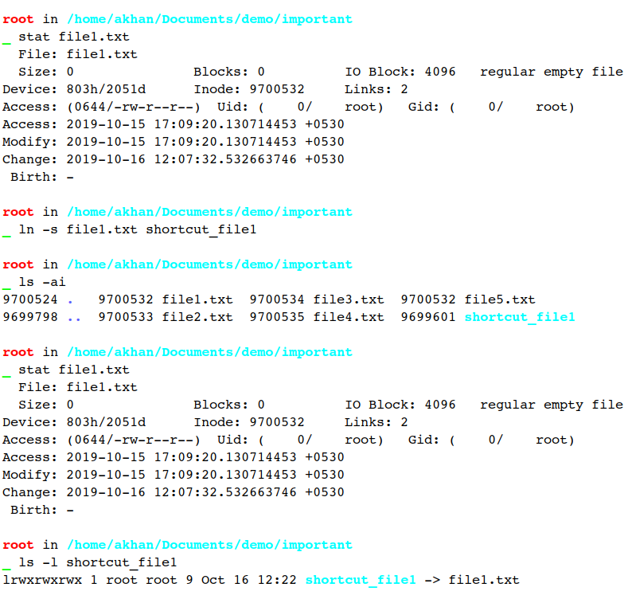
Symbolic link is also a means of referencing a file.
It is created with ln -s command.

Slide 19
Key Takeaways on Links
Hardlink | Softlink
Does not create a new inode | Create a new inode
Cannot link directories unless it is done by root | Can link directories
Cannot link files across file systems | Can link files across file system
Increase hard link count of the linked inode | Does not change hard link count of the linked inode

Slide 20
Thank You!

